Slide 1
Obstruction Detection
By Samuel Okei and Zawad Niamat

Slide 2
Problem Description
Solution
Problem:
Classify images as rover/car traversable or not (Traversable +, Non-traversable -).
Improve classifier using feature extraction (85% accuracy without).
Enable classifier to train on small set (trained on 1600 images).
Enable classifier to train on simple network (uses 5 layers with trainable params).
Train GAN (Generative Adversarial Networks) to generate images that follow two constraints:
They come from the distribution of positive images
They resemble the input image
Why :
The difference between the generated image and real image for the positive image should be small and should be large for negative images.
This should improve the results of the classifier.

Slide 3
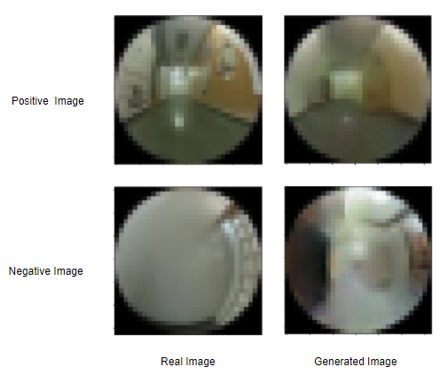
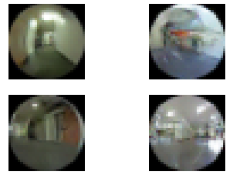
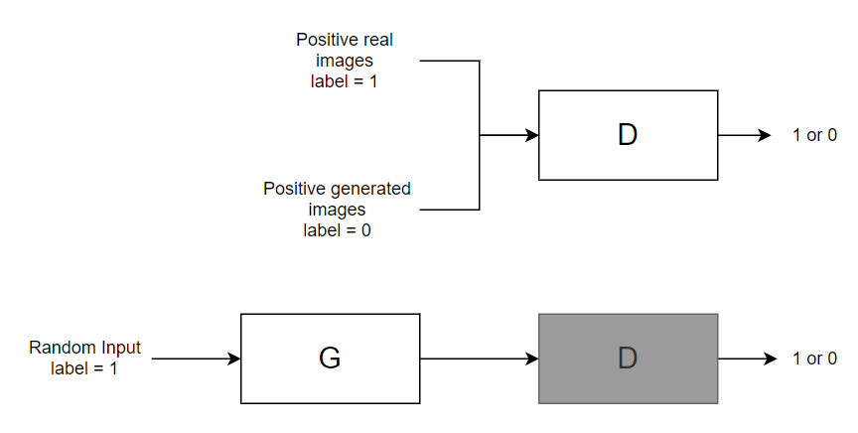
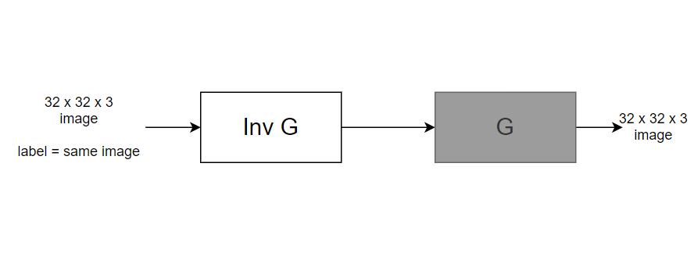
GAN Network

Slide 4
Best Classifier
 | Gold Positive | Gold Negative
Pred Positive | 368 | 15
Pred Negative | 32 | 385
Accuracy: 94 %
Precision: 0.96
Recall: 0.92
F1-score: 0.94
The reason for a bias towards predicting a negative is as a result of incomplete GAN training. Some positive images generate images with high difference and are classified as negative. This might be a good thing as false positives mean a crash.

Slide 5
Other Algorithms
Bagged CNN: 93%
SVM: 82.5%
PCA SVM: 81%
Decision trees: 71%
Random Forest (DT): 84%
CNN's massively outperforms others because it retains spatial and temporal information.

Slide 6
Takeaways
GANs and Data Distributions:
All data with info are noisy distributions with unknown parameters
Reason for feature extraction:
Aim at reducing error from noise
Reason for CNN’s
Retains temporal and spatial information of images

